Slide 1
IT PROJECT MANAGEMENT
Project Integration Management
2023

Slide 2
Objectives
Project Integration Management
Strategic Planning and Project Selection
Strategic Planning
Identifying Potential Projects
Methods for selecting projects
Focusing on broad organizational needs
Categorizing IT projects
Performing financial analyses

Slide 3
Project Integration Management
Project integration management involves coordinating all of the other project management knowledge areas throughout a project’s life cycle.
This integration ensures that all the elements of a project come together at the right times to complete a project successfully.

Slide 4
Project Integration Management
Six main processes are involved in project integration management:
Developing the project charter :
involves working with stakeholders to create the document that formally authorizes a project.
2. Project management plan:
involves coordinating all planning efforts to create a consistent, coherent document.

Slide 5
Project Integration Management
3. Directing and managing project work
Involves carrying out the project management plan by performing the activities included in it.
The outputs of this process are
deliverables,
work performance information,
change requests,
project management plan updates, and
project documents updates.

Slide 6
Project Integration Management
4. Monitoring and controlling project work
involves overseeing activities to meet the performance objectives of the project.
The outputs of this process are
change requests,
project management plan updates, and
project documents updates.

Slide 7
Project Integration Management
5. Performing integrated change control
involves identifying, evaluating, and managing changes throughout the project life cycle.
The outputs of this process include
change request status updates,
project management plan updates, and
project documents updates.

Slide 8
Project Integration Management
6. Closing the project or phase
involves finalizing all activities to formally close the project or phase.
Outputs of this process include
final product,
service, or result transition and
organizational process assets updates.

Slide 9
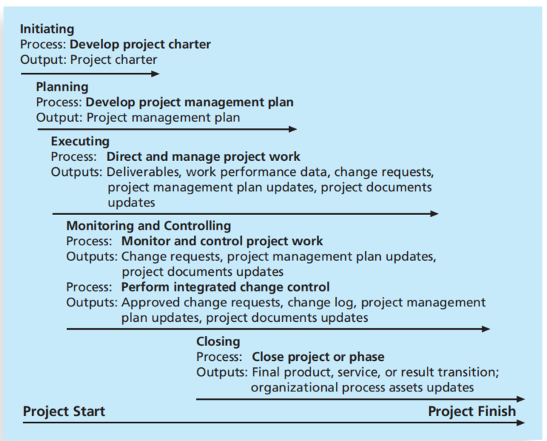
Project Integration Management
Figure 2. summarizes these processes and outputs, and shows when they occur in a typical project.

Slide 10
Strategic Planning and Project Selection
This is where leaders take strategic plan of the organization to determine what types of projects will provide the most value.
Top management is usually responsible for these types of business decisions.
Successful organizations include project managers to provide valuable insight into the project selection process.

Slide 11
Strategic Planning and Project Selection
Strategic Planning
Strategic planning involves determining long-term objectives by analyzing the strengths and weaknesses of an organization, studying opportunities and threats in the business environment, predicting future trends, and projecting the need for new products and services.
Strategic planning provides important information to help organizations identify and then select potential projects.

Slide 12
Strategic Planning and Project Selection
Many people are familiar with SWOT analysis—analyzing
Strengths,
Weaknesses,
Opportunities, and
Threats
SWOT analysis is one tool used in strategic planning.
For example, a group of four people who want to start a new business in the film industry could perform a SWOT analysis to help identify potential projects.

Slide 13
Strategic Planning and Project Selection
They might determine the following based on a SWOT analysis:
Strengths:
As experienced professionals, we have numerous contacts in the film industry.
Two of us have strong sales and interpersonal skills.
Two of us have strong technical skills and are familiar with several filmmaking software tools.
We all have impressive samples of completed projects.

Slide 14
Strategic Planning and Project Selection
Weaknesses:
None of us have accounting or financial experience.
We have no clear marketing strategy for products and services.
We have little money to invest in new projects.
We have no company Web site and limited use of technology to run the business.

Slide 15
Strategic Planning and Project Selection
Opportunities:
A potential client has mentioned a large project she would like us to bid on.
The film industry continues to grow.
There are two major conferences this year where we could promote our company

Slide 16
Strategic Planning and Project Selection
Threats:
Other individuals or companies can provide the services we can.
Customers might prefer working with more established individuals and organizations.
There is high risk in the film business.

Slide 17
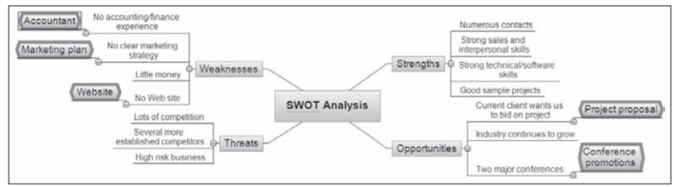
Strategic Planning and Project Selection
Figure 1. Mind map of a SWOT analysis to help identify potential projects

Slide 18
Methods for Selecting Projects
Organizations identify many potential projects as part of their strategic planning processes, and they need to narrow down the list of potential projects to the ones that will be of most benefit.
They often rely on experienced project managers to help them make project selection decisions.
Selecting projects involves many methods.

Slide 19
Methods for Selecting Projects
Five common techniques are:
Focusing on broad organizational needs
Categorizing IT projects
Performing net present value or other financial analyses
Using a weighted scoring model
Implementing a balanced scorecard

Slide 20
Focusing on Broad Organization Needs
Organizational needs
This is to determine whether they first meet three important criteria: need, funding, and will.
Do people in the organization agree that the project needs to be done?
Does the organization have the desire and capacity to provide adequate funds to perform the project?
Is there a strong will to make the project succeed?
For example, many visionary CEOs can describe a broad need to improve certain aspects of their organizations, such as communications.

Slide 21
Categorizing IT Project
Another method for selecting projects is based on various categorizations, such as the
project’s impetus,
time window, and
general priority.
The impetus for a project is often to respond to a problem, an opportunity, or a directive.

Slide 22
Categorizing IT Project
Problems are undesirable situations that prevent an organization from achieving its goals.
These problems can be current or anticipated.
For example, users of an information system may be having trouble logging on to the system or getting information in a timely manner because the system has reached its capacity.
In response, the company could initiate a project to enhance the current system by adding more access lines or upgrading the hardware with a faster processor, more memory, or more storage space

Slide 23
Categorizing IT Project
Opportunities are chances to improve the organization.
For example, creating a new product that can make or break the entire company.
Directives are new requirements imposed by management, government, or some external influence.
For example, many projects that involve medical technologies must meet rigorous government requirements.

Slide 24
Categorizing IT Project
Time window
Another categorization for IT projects is based on timing
How long will it take to complete a project and what is the deadline for completing it?
For example, some potential projects must be finished within a specific time window; otherwise, they are no longer valid projects.
Some projects can be completed very quickly—within a few weeks, days, or even minutes.

Slide 25
Categorizing IT Project
General Priority
Organizations can also categorize IT projects as having high, medium, or low priority based on the current business environment.
For example, if it is crucial to cut operating costs quickly, projects that have the most potential to do so would be given a high priority.
An organization should always complete high-priority projects first, even if a low- or medium-priority project could be finished in less time.
Usually an organization has many more potential IT projects than it can undertake at one time, so it is crucial to work on the most important projects first.

Slide 26
Performing Financial Analyses
Financial considerations are an important aspect of the project selection process, whether economic times are tough or the economy is growing.
Many organizations require an approved business case before pursuing projects, and financial projections are a critical component of the business case.

Slide 27
Performing Financial Analyses
Three primary methods for projecting the financial value of projects include;
net present value (NPV) analysis,
return on investment (ROI), and
payback analysis.

Slide 28
Performing Financial Analyses
Net Present Value Analysis
Time value of money principle: Most people know that a dollar earned today is worth more than a dollar earned five years from now.
Many projects have financial implications that extend into the future.
In order to evaluate potential projects equally, you need to consider their net present value.

Slide 29
Performing Financial Analyses
Net Present Value Analysis
Net present value (NPV) analysis is a method of calculating the expected net monetary gain or loss from a project by calculating the value of all expected future cash inflows and outflows at the present time.

Slide 30
Net Present Value Analysis
Net Present Value Analysis
An organization should consider only projects with a positive NPV if financial value is a key criterion for project selection.
A positive NPV means that the return from a project exceeds the cost of capital—the return available from investing the capital elsewhere.
In other words, the cost of capital is the rate of return that could have been earned by putting the same money into a different investment with equal risk.
Projects with higher NPVs are preferred to projects with lower NPVs, if all other factors are equal.

Slide 31
Net Present Value Analysis
To calculate NPV, you must assume a certain discount rate.
The discount rate is the interest rate used to discount cash flows.
It takes into account not just the time value of money but also the risk or uncertainty of future cash flows.
The greater the uncertainty of future cash flows, the higher the discount rate.
It is also called the capitalization rate or the opportunity cost of capital.

Slide 32
Net Present Value Analysis
Net Present Value Analysis
1. Determine the estimated costs and benefits for the life of the project and the products it creates.
2. Determine the discount rate.
3. Calculate the net present value.
Most spreadsheet software has a built-in function to calculate NPV. For example,
Microsoft Excel uses: NPV(discount rate, range of cash flows).

Slide 33
Return on Investment
Another important financial consideration is return on investment.
Return on investment (ROI) is the result of subtracting the project costs from the benefits and then dividing by the costs.
For example, if you invest $100 today and next year it is worth $110, your ROI is ($110 – 100)/100 or 0.10 (10 percent).
Note that the ROI is always a percentage.
It can be positive or negative.
For multiyear projects, it is best to use discounted costs and benefits when calculating ROI.

Slide 34
Net Present Value Analysis
Discount rate | 8%
Project 1 | Year 0 | Year 1 | Year 2 | Year 3 | Total
Costs | 140,000 | 40,000 | 40,000 | 40,000
Discount factor
Discounted cost
Benefit | 0 | 200,000 | 200,000 | 200,000
Discount factor
Discounted Benefit
Cash flow
Cumulated cash flow
Cumulative benefit = Discounted benefit – Discounted cost
Cumulative Cash flow = Cumulative benefit – Discounted cost

Slide 35
Net Present Value Analysis
Discount rate | 8%
Project 2 | Year 0 | Year 1 | Year 2 | Year 3 | Total
Costs | 200,000 | 40,000 | 50,000 | 60,000
Discount factor
Discounted cost
Benefit | 5000 | 200,000 | 300,000 | 400,000
Discount factor
Discounted Benefit
Cash flow
Cumulated cash flow
Cumulative benefit = Discounted benefit – Discounted cost
Cumulative Cash flow = Cumulative benefit – Discounted cost

Slide 36
Net Present Value Analysis
1. Calculate for the Net Present Value (NPV) for the project.
2. Which of the projects is good to undertake? Why?
3. Calculate for the Return on Investment (ROI).

Slide 37
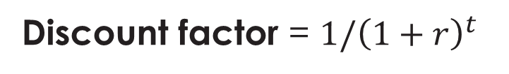
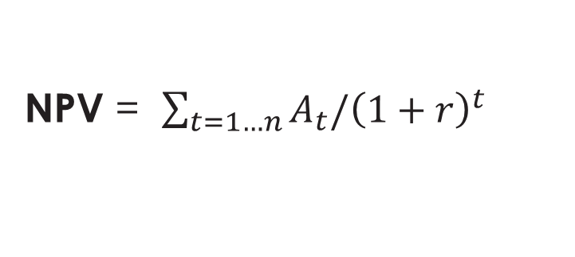
Net Present Value Analysis
Formulars
Where; A = Amount of cash flow in each year, r = discount rate, and t = year
NPV = $\sum_{t=1…n}{A_{t}/{\left(1+r\right)}^{t}}$
Discount factor = $1/{\left(1+r\right)}^{t}$
Where r = discount rate, and t = year
ROI= $\frac{Total Discounted Benefit −Total Discounted Cost}{Total Discounted Cost}×100$

Slide 38
Net Present Value Analysis
Discount rate | 5%
Project | Year 0 | Year 1 | Year 2 | Year 3 | Total
Costs | 120000 | 20000 | 20000 | 20000
Discount factor
Discounted cost
Benefit | 0 | 150000 | 150000 | 150000
Discount factor
Discounted Benefit
Cash flow
Cumulated cash flow
Cumulative benefit = Discounted benefit – Discounted cost
Cumulative Cash flow = Cumulative benefit – Discounted cost

